Slide 1

Accounting with International Accounting
Bachelor of Applied Science
“AIA BAS”
Earl Sedlik, Faculty Coordinator
Program Name
Goes Here
Presenter Name Goes Here
Notes:
Welcome, introduce yourself and the program. Feel free to share about your education/career background, how long you’ve been teaching, etc.

Slide 2
AIA BAS DEGREE
Short Description
Bachelor’s degree in International Accounting.
Prepares graduates for an Accounting career.
Academic pathway toward taking the CPA Exam.
Completely Online – most students are working in Accounting.
Structured Academic Sequence.
Dedicated Academic Advisory Support
Where is this program offered?
North Seattle College
– Delivered Completely Online

Slide 3
AIA BAS DEGREE
Junior Status
Entry Requirements:
ACCOUNTING PRINCIPLE COURSES:
  ACCT&201, ACCT&202, & ACCT&203
BUSINESS COURSES:
  Business Law - BUS&201
  Statistics - BUS210 or MATH&146
ENGLISH COMPOSITION - ENGL&101

Slide 4
AIA BAS DEGREE
SO...
WHY ACCOUNTING?
AND...
WHY THIS AIA BAS PROGRAM IS FOR YOU!

Slide 5
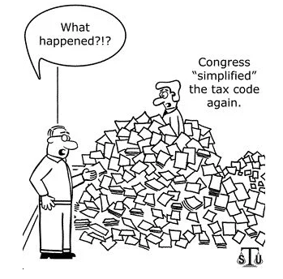
ACCOUNTANTS
“STAY ON TOP OF”
ALL CHANGES

Slide 6
ACCOUNTANTS ARE:
PROBLEM SOLVERS…
An accountant is someone who
solves a problem...

Slide 7
ACCOUNTANTS ARE:
PROBLEM SOLVERS…
An accountant is someone who
solves a problem...
you didn't know you had...

Slide 8
ACCOUNTANTS ARE:
PROBLEM SOLVERS…
An accountant is someone who
solves a problem...
you didn't know you had...
in a way you don’t understand.

Slide 9
COMPELLING REASONS TO BECOME AN ACCOUNTANT - part 1
FAMILY ENCOURAGEMENT
GRANDMA SAYS: “Everybody needs an accountant!”
GRANDPA SAYS: “You’ll always have a job!”
DAD SAYS: “You’ll make a lot of money!”
AUNT IDA SAYS: “You’ll always be in an industry you like!”
MOM SAYS: “DO WHATEVER BRINGS YOU JOY!”

Slide 10
COMPELLING REASONS TO BECOME AN ACCOUNTANT – part 2
REALITY SAYS:
“Everybody needs an accountant!”
“You’ll always have a job!”
“You’ll make a lot of money!”
“You can work in any industry your like!”
BUT... Mom is right!
YOU MUST FEEL THE JOY OF
BEING AN ACCOUNTANT...

Slide 11
COMPELLING REASONS TO BECOME AN ACCOUNTANT – part 3
ENJOY THE PRIDE OF
Meeting Deadlines
Keeping & Presenting Accurate Data in a Timely Manner
Impacting every Important Decision
Making Important Decisions
Providing the Right Answer
Knowing that everyone relies on you...
to do the right thing!

Slide 12
AIA BAS STUDENTS LEARN
ADVANCED ACCOUNTING GUIDELINES AND SKILLS WHILE:
  COMPLETING THE CPA EXAM ACADEMIC CREDENTIALS
  FOCUSED ON INTERNATIONAL ACCOUNTING
    WHICH IS A GROWING FOCUS OF SKILLS
    VERY IMPORTANT FOR REGIONAL BUSINESSES
STUDENTS ELEVATE THEIR
ACCOUNTING COMPETENCIES
TOWARD A SUCCESSFUL CAREER

Slide 13
AIA BAS STUDENTS ENJOY
LEARNING FROM EXPERIENCED INSTRUCTORS
  EXPERIENCED MBAs APPLYING CAREER REALITIES
  CPAs DEDICATED TO ACCOUNTING EDUCATION
  PROFESSIONALS WHO:
    Integrate real-world examples into education.
    Serve on national committees to shape innovative changes in Accounting Education.
THE TEACHERS TELL THE FULL STORY:
THE FULL STORY VIDEO:
    https://youtu.be/h-Dfej7oRHo

Slide 14
Education Pathway
After you complete an associate degree:
Two-year program with Fall start
Two courses per quarter
  Three quarters per calendar year
Sequenced Courses build growth
Coordinated Internship Program

Slide 15
AIA BAS STUDENTS ENJOY
FLEXIBILITY
  Can learn while working
CONSISTENCY
  Common “cohort” experience
  New group starts together each Fall
SUPPORT
  Personal Academic Advisory Services

Slide 16
Careers/Jobs
Accounting Career Patterns
  Vary in shape & timing
  All paths lead to responsible positions
Three Popular Pathways:
Public Accounting
Corporate Accounting
Not-for-Profit Accounting

Slide 17
Public Accounting Firms
  CPA track leading toward Partnership
  Auditing
  Client Coordination
  Specialties – often independent CPA entities
    Taxation
    Data Analytics – applying sophisticated computer models and Artificial Intelligence(AI)
    Not-For-Profit support
    Forensic Accounting (Fraud exploration)

Slide 18
Corporate & Not-for-Profit Accounting – entry level positions
  Payroll processing
  Accounts Payable – paying bills
  Accounts Receivable – collecting revenue
  Financial Reporting – crafting detailed reports
  Data Processing and Analysis
  Providing Data for Decision-Making
  Planning Capital Investments
  Coordinating Financing support & processing
  Presenting Operational Reports

Slide 19
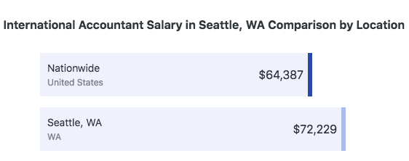
SEATTLE ACCOUNTING SALARIES
OVER 12% HIGHER THAN
THE NATIONAL AVERAGE
Source: www.ziprecruiters.com

Slide 20
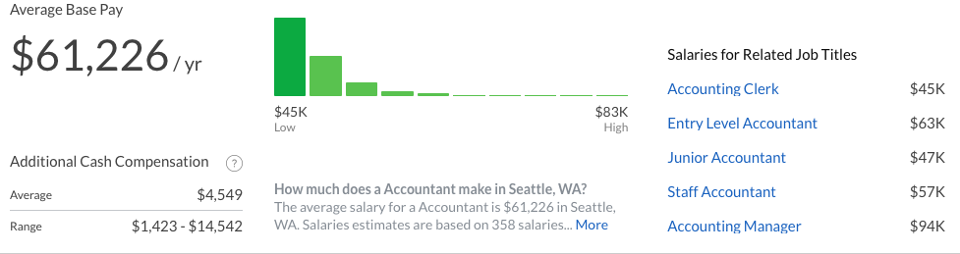
ACCOUNTING SALARIES IN SEATTLE
Accounting Job Salaries in Seattle
Source: www.glassdoor.com

Slide 21
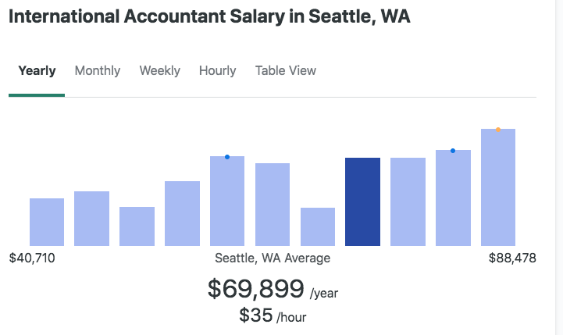
INTERNATIONAL ACCOUNTANTS
SEATTLE SALARIES
Source: www.ziprecruiters.com

Slide 22
CPA SALARIES IN SEATTLE
The average salary
for someone with a CPA
Certified Public Accountant designation
in Seattle, WA
is between $76,795 and $504,073
as of March 29, 2021.
Source: www.salary.com

Slide 23
AIA BAS DEGREE PROGRAM
ENROLLMENT REQUIREMENTS
Incoming students need:
An Associate Degree
or 75+ credits up to upper-level (300/400) courses
with
Completion of these “required-for-entry” courses:
ACCOUNTING PRINCIPLE COURSES:
  ACCT&201, ACCT&202, & ACCT&203
BUSINESS COURSES:
  Business Law BUS&201
  Statistics BUS210 or MATH&146
ENGLISH COMPOSITION - ENGL&101
FOR FURTHER INFORMATION ABOUT THE AIA BAS DEGREE CONTACT
Jesse Cooley, Director – BAS Business Programs
Email: Jesse.Cooley@seattlecolleges.edu

Slide 24
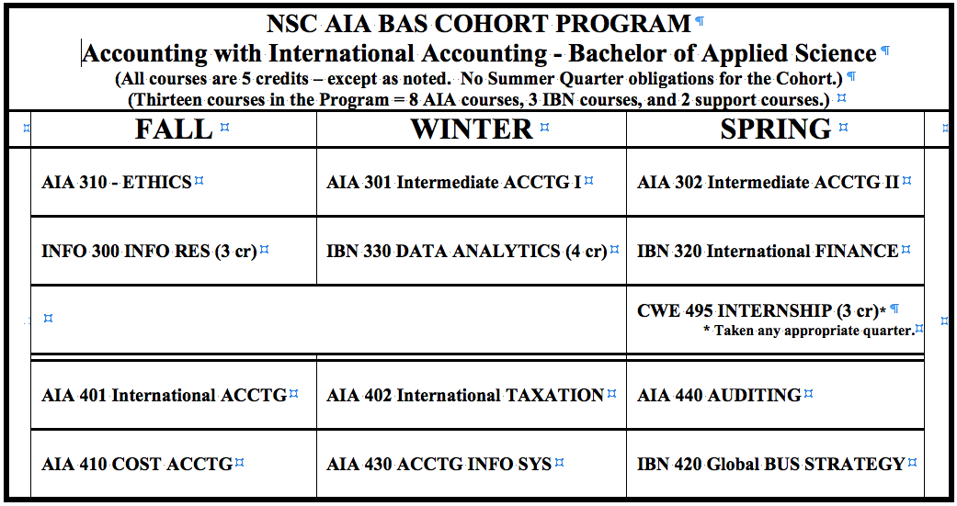
AIA BAS DEGREE PROGRAM Q & A
FOR FURTHER INFORMATION ABOUT THE AIA BAS DEGREE CONTACT
Jesse Cooley, Director – Business BAS Programs
Email: Jesse.Cooley@seattlecolleges.edu

Slide 25
AIA BAS DEGREE PROGRAM Q & A
THESE RESOURCES TELL
THE AIA BAS STORY
THE FULL STORY VIDEO
    https://youtu.be/h-Dfej7oRHo
THE AIA BAS PROGRAM WEBSITE
    https://northseattle.edu/programs/accounting/accounting-international-accounting-bas
FOR FURTHER INFORMATION
ABOUT THE AIA BAS DEGREE
CONTACT
Jesse Cooley, Director – Business BAS Programs
Email: Jesse.Cooley@seattlecolleges.edu

Slide 26

Return to Main Session
(select “Leave Breakout Room” to return)

